Slide 1
Research Skills 1
Week 1
Course Introduction
Lecturer’s Version

Slide 2
Learning Outcomes
To understand the aims of the module and how you will be assessed
To get to know your classmates
To know what you should be doing in lectures
To establish ground rules for classroom conduct
To understand the role of the lecturer and the student
To be able to navigate the VLE

Slide 3

Articulation
This session develops skills needed for assessments. It also covers IT skills for the rest of your courses at university.
This sessions also develops employability skills, specifically: Communication skills (oral) and Interpersonal skills
The textbook for this module is How to Use Your Reading in Your Essays by Jeanne Godfrey
You can open it by clicking on the picture in your Kortext bookshelf on the right-hand side of your VLE page.

Slide 4
Module overview: What will I learn in this course?
Research Skills is a 30-credit module split into 2 parts. Each part is 12 weeks long.
Research Skills 1 runs from 9 May to 1 Aug.
Research Skills 2 runs from 16 September 8 December.
Research Skills 1 aims to develop your understanding of:
the requirements of higher education,
the types of sources used in academic work and how to find them.
It will also help you to develop skills including:
IT skills, which will allow you to research and find academic sources,
communication skills (written and oral), which will allow you to present information from sources in your own work.
Research Skills 2 aims to develop your skills so that you can use sources to support points in a written piece of work.

Slide 5
How will I be assessed?
Research Skills 1
Practical assessment – Find an online source and evaluate it.
Week 11 and 12 in your usual class time
The practical assessment is 50% of the final grade.
Research Skills 2
Essay (1,500 words)
Week 13 of trimester 1.
The essay is 50% of the final grade.

Slide 6
How will the course help me prepare for the assessment?
On this course your lecturer will:
Show you how to find sources online using various search strategies.
Provide plenty of practice opportunities so that you can hone your search skills.
Teach you how to evaluate the reliability of a source.
Give you opportunities to practise evaluating sources verbally.
Of course, to get the most out of this course you will need access to a device you can use to conduct online searches and attend class regularly.
Please note that if you miss a class, it is your responsibility to catch up via the VLE.

Slide 7
Activity 1: Self-Assessment
Find out how much you already know about research skills – you may know more than you think.
Download the class handout.
Look at the questions on your class handout and decide how confident you feel about these skills. Remember, this is not a test! If you don’t feel at all confident, don’t worry, this course will help you develop your skills and your confidence.
If you do feel confident, that’s great! You will be able to develop and hone your skills.
We will revisit this at the end of the module and you should see the progress you have made!

Slide 8
Activity 2: Getting to know your classmates
Friends made at university often become life-long friends.
This is because you are sharing a fairly intense, unique experience.
University classmates often form part of your professional network.
In groups, find out as much as you can about your classmates. You can use the questions on the handout to help you if you can’t think of what to say!

Slide 9
Navigating the Research skills 1 VLE page
Each Module has a VLE page. This is where you can find all the information you need about your module.
Watch the short video which will show you around our module page.
You will find out:
Where to find the class materials
Where to find the answers
What quizzes look like
Where to find the videos which go with the classes
Where to find module information (including course dates)
Where to find your textbook
Where to access the library
Where to find assessment information
Where to find extra resources

Slide 10
Activity 3 - Navigating the Research Skills 1 VLE page
Using what you have just learned about the VLE page, find the answers to the questions on the handout.

Slide 11
Activity 3 Answers
What are we studying about next week in Research Skills 1? The Importance of reliable source – fake news – how to do an online search
Is there a quiz I have to do next week? Yes, students always have to do all of the quizzes.
Where can I find the find video for this class? My Modules – Research Skills 1 – Lecture Recordings
Where do find information about the assessment? My Modules – Research Skills 1 – Assessments and Assessment information
When is the assessment for RE1? Weeks 11 + 12
When can I see the answers for the materials in class? At the end of each week
Can I prepare ahead of the class? Yes, you can see the class materials 2 weeks ahead of time
What do I do if I miss a class? Go through the materials and watch the video

Slide 12
Lectures
It is not enough to only attend lectures. As full-time students you are expected to study 12 hours per week outside of lectures (that’s 3 hours of extra work for every lecture you attend)
Your lectures are 3 hours long.
The average attention span of an adult is about 14 minutes (Elsworthy, 2017)
At some point your mind will wander off task, this is normal.
Lecturers break up the 3-hour sessions into lectures and tasks to keep students focused.

Slide 13
How to get the most out of lectures
Be prepared
The lecture materials are made available to you two weeks ahead of time.
By going through the materials before class, you will be able to ask any questions on points you want clarified. You will also be able to contribute in a meaningful way.
Do the quizzes
The quizzes test your understanding of the main content of the lecture. They are also quite short, so are quick to do.
The quizzes are also used to track engagement.
Do the reading
Each class is supported by a chapter from your textbook accessed on Kortext – ‘How to use your reading in your essays’ by Jeanne Godfrey.
This will give you a deeper understanding of what we are studying.

Slide 14
How to get the most out of lectures
Make sure your tech is working
Make sure you have access to a computer. Make sure you can log in to your emails, VLE, digital library and Kortext.
This is your responsibility, not the responsibility of the lecturer. If you have any issues, contact Online Support on the VLE- My Modules- Online support. This should be done outside of lectures
Don’t miss lectures (even if you are busy or tired or just fed up)
Coming to lectures is always better than not coming.
If you miss a class, catch up!
Work through the lecturer’s version of the material with the answers. Watch the videos to help you to catch up.
Have a positive attitude
Where there is a will, there is a way! You have the full support of the university and your lecturers behind you!

Slide 15
Activity 4: Ground Rules
The most successful classes work well together, they support each other and raise each other up.
This doesn’t happen by chance, it happens because there is a mutual understanding between class members.
In groups discuss some ‘ground rules’ for how you would like your class to behave. This could range from general ideas such as ‘respect your classmates’ to more specific ideas such as ‘only speak in English’.
Note down your ideas on the class handout.

Slide 16

Share your ideas with the class

Slide 17
Role of the Lecturer
Your lecturer is responsible for taking you through the materials, guiding you through the assessments and giving you feedback.
Your lecturer will teach you key academic skills and highlight the employability skills as we go through the course.
Your lecturer will give you opportunities to practise the skills you need for the assessment and for the rest of your university study.

Slide 18
Role of the Student
At university, you are expected to be an independent learner.
What is independent learning?
Independent learning is when an individual is able to think, act and pursue their own studies autonomously, without the same levels of support you receive from a teacher at school.
You are responsible for your own time management and management of digital resources. To become a good independent learner you need to be:
Motivated
Resilient, to overcome challenges
An excellent time manager

Slide 19
Role of the Student
Students are expected to do research, assignments and prepare for lectures outside of class time. If you only come to lectures, you are only doing half the work.
Students are also expected to manage their time and hand in work on time.

Slide 20
University Life – Getting the most out of it
Congratulations for getting into university!
For the next 4 years you will be full-time students
Full-time study is the equivalent to full-time work.
Getting a university degree is not easy, which is why only two-fifths of the UK’s working population have a degree (Statista, 2022)
When things get tough, it is good to remember why you are here!

Slide 21
Personal Skills – Be Confident
Everyone has skills that will help them in an academic setting, regardless of whether you know how to structure an essay or not.
It’ s not just your intelligence that will get you through the next 4 years. It’s also your personal skills.
There will be times when you don’t feel like studying or you feel overwhelmed. This is where your personal skills will carry you through.
Your past experience will be different from your classmates’, your past education and your personal challenges influence the way you are now as a student.

Slide 22
Activity 5: Identifying current skills and qualities
1) Look at the table on your handout and tick the skills and qualities that you currently have.
2) Highlight any skills that you need to work on.
3) In your groups, talk about how the skills relate to university life and the workplace. Choose one skill/quality to talk about from each category.

Slide 23
Motivation
Your level of motivation will affect your success.
No matter how much you love your subject or want to gain a good degree, there may be times when you don’t feel like studying or wonder whether you would be better off doing something else.
You need strong motivation to keep yourself going at such times

Slide 24
Activity 6: Motivation
To find out your levels of motivation, work with a partner and ask each other the questions on your handout.
Don’t forget to add up your scores out of 100 at the end.
You can refer back to this document from time to time during the course.
Share your top tips for motivation with your group.

Slide 25
The VLE
Most universities use a Virtual Learning Environment (VLE).
It is a platform which is used to communicate key information.
Everything you need to know about student life and studying can be found on the VLE.
The VLE is constantly evolving becoming more user friendly each trimester.
So always look out for new developments on the VLE.
In the next few slides, we will show you some of the highlights of the VLE – do pay attention as there is a quiz at the end!

Slide 26

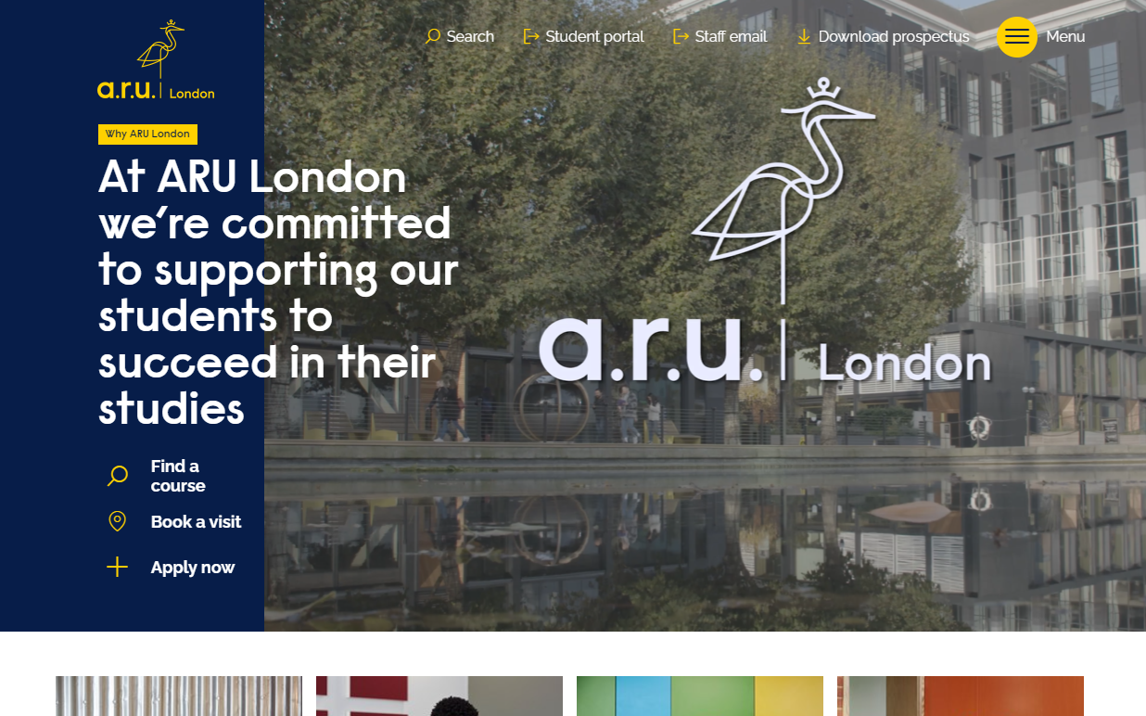

How to access the VLE
https://london.aru.ac.uk/
Notes:
demo

Slide 27
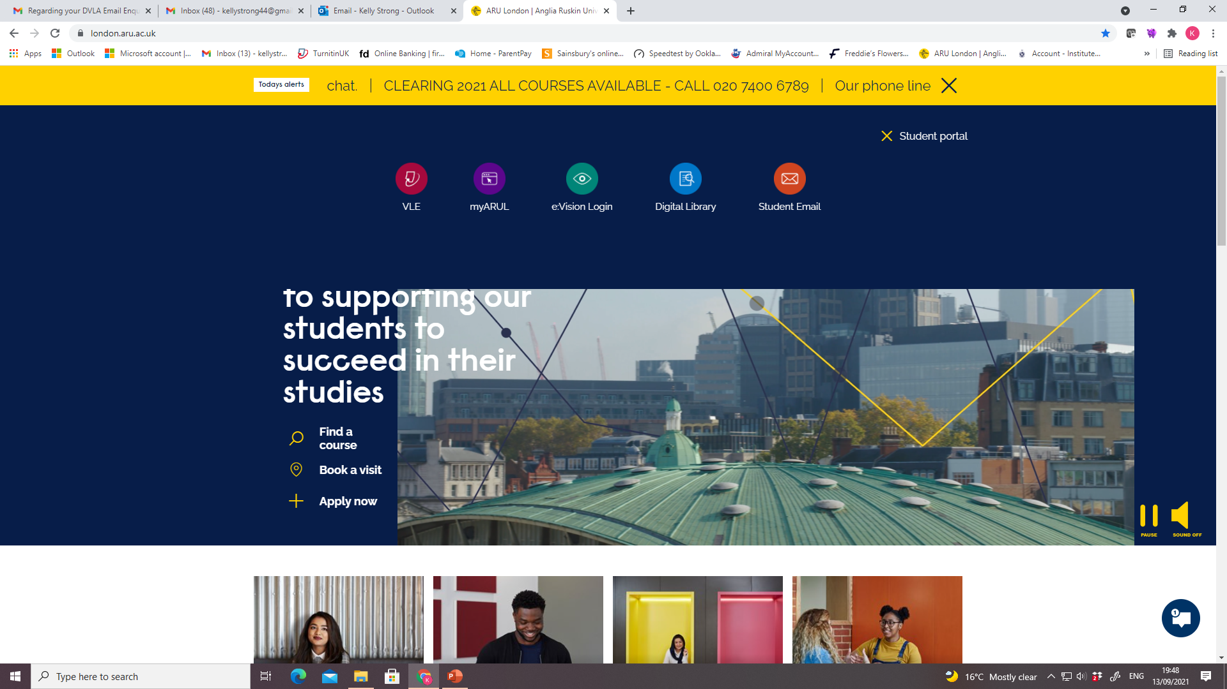
Select VLE
Notes:
This is what students see if they access via the ARUL website and click student services
PDT: Talk through icons
VLE (Moodle) – this is how they access their modules, zoom links, coursework notes, lecture slides, lecture notes, videos, additional learning.
myARUL (web based version of the app) – they can access student email, timetable, ARU library, News, Guides, Key Dates, links to e:Vision / Kortext.
Additional VLE services – career zone (employability tools), attendance monitoring, online forms (letter requests / forms / replacement cards etc.), timetable, accounts, handbooks.
Student email, this is where we recommend they go through the MFA for ease

Slide 28
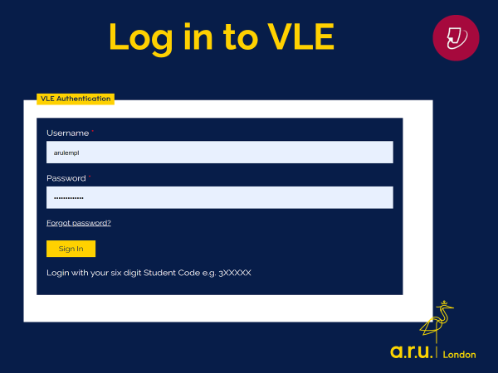
Access to VLE
Your username is your student number starting with 3.
Your password is your date of birth (6 digit format).

Slide 29

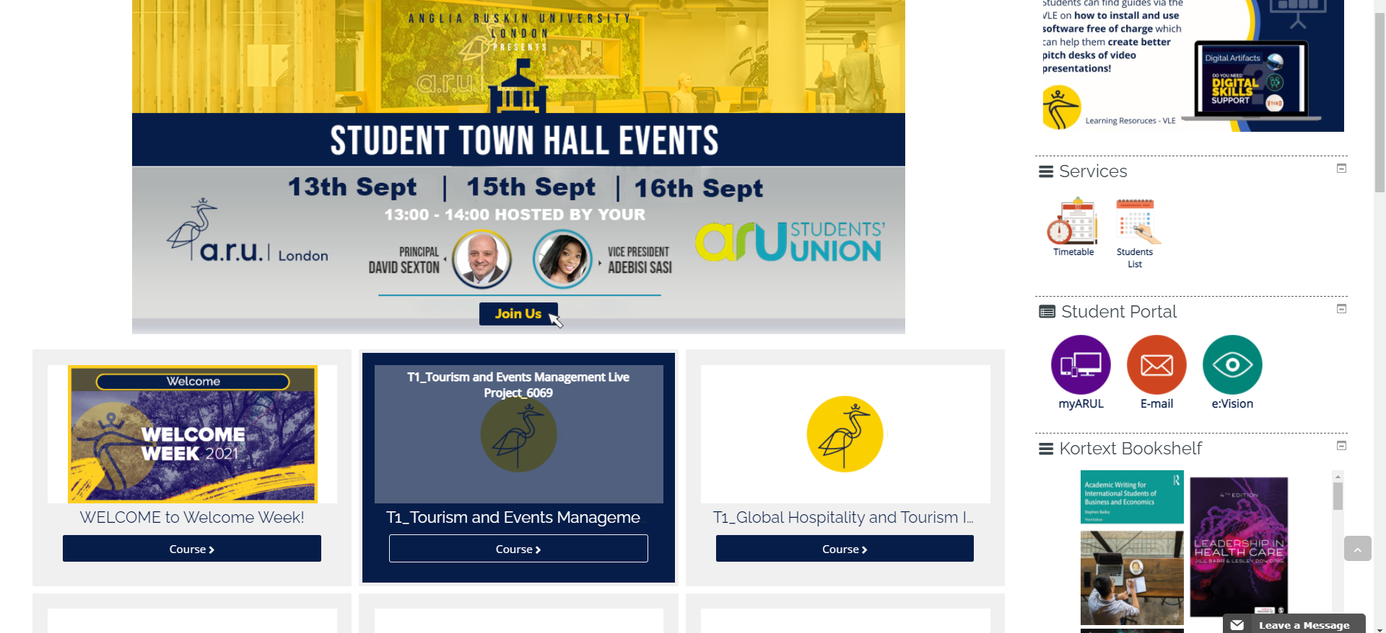
Your Modules
Notes:
When they click on online learning they see the above

Slide 30
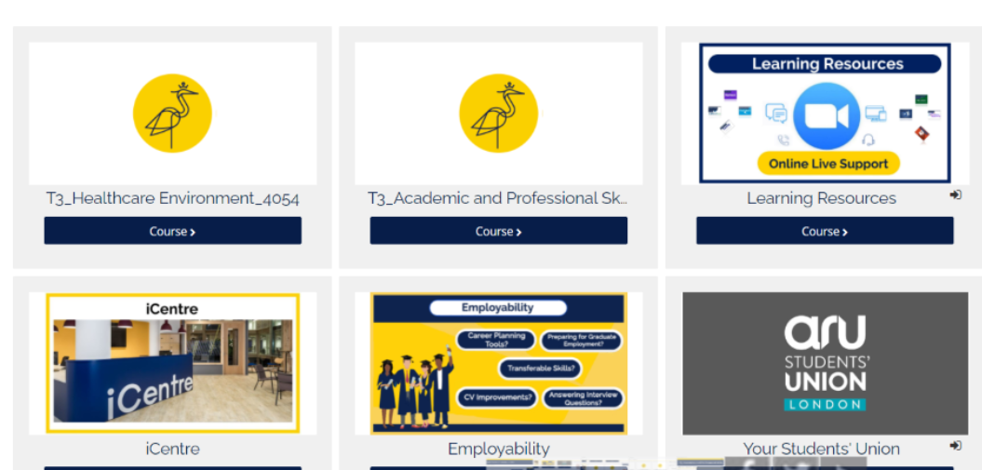
Inside My Modules As well as the modules you are studying, you will also find the following:

Slide 31
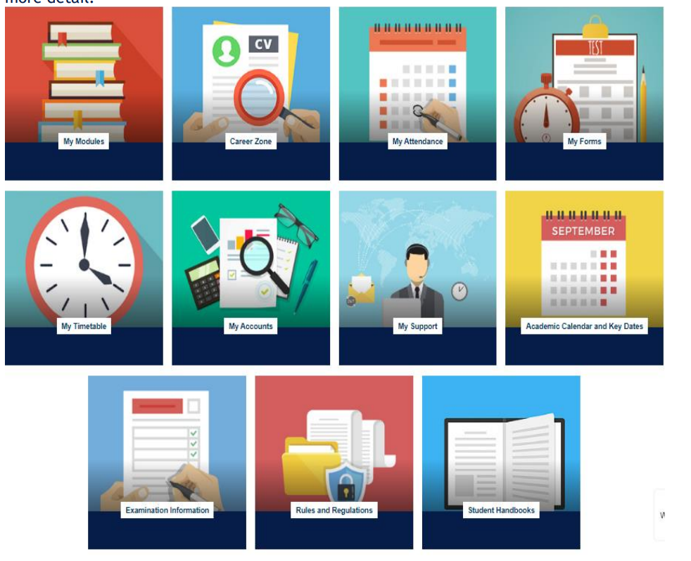
This is your VLE home screen
My Modules – all your class information
Career Zone – CV builder, jobs board etc.
My Attendance – track your attendance.
My Forms – Change of course/timetable, assessment extension form/ letter request form
My Timetable – when and where you have classes
My Accounts – course fees/ balance
My Support - Guides and procedures e.g. attendance procedure
Academic Calendar – Key dates such as start and end of trimesters
The other three are self explanatory.

Slide 32


Slide 33
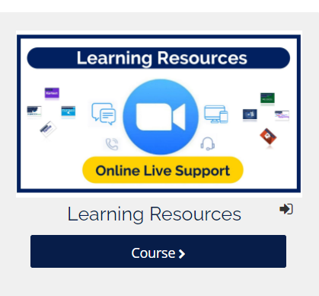
My Modules - Learning Resources Online Live Support
Click here for any online/ computer/ technical issues – there is a team waiting to help you.
You can also find workshops for using Word, PowerPoint and Excel (Very useful, particularly if you are worries about your IT skills)

Slide 34
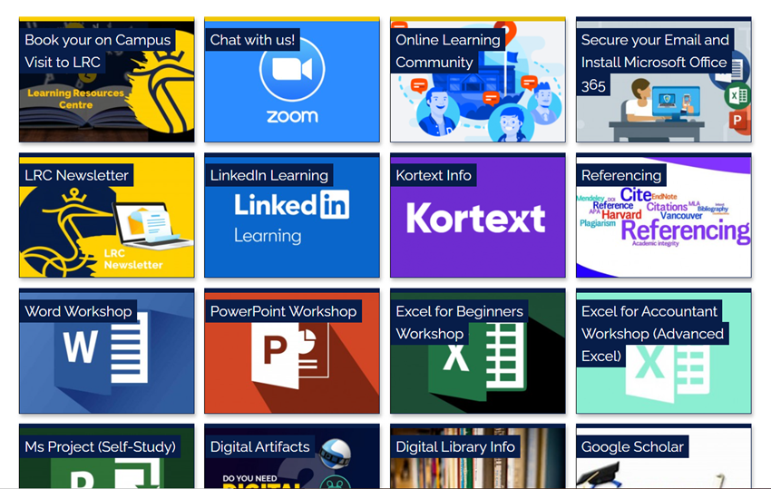
My Modules - Learning Resources - Online Live Support

Slide 35
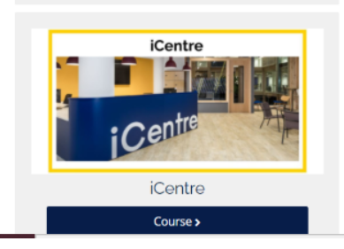
My Modules - iCentre
Zoom sessions – 9-10.30am and 1-2pm
Help and advice on:
Key dates, Attendance processes, student benefits, EU advice
You can also contact the iCentre via the chat function – Zen Help Desk

Slide 36
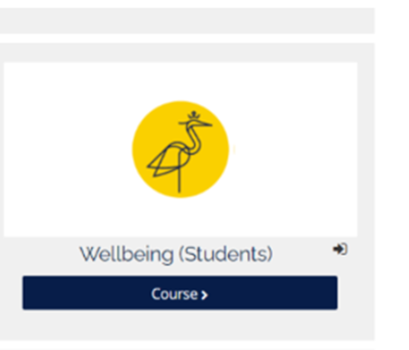
My Modules - Wellbeing
Information on how to refer to the wellbeing team
Information on wellbeing

Slide 37
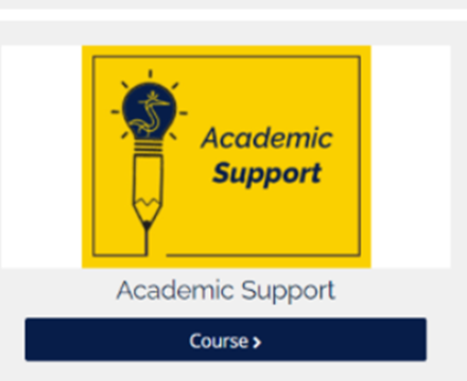
My Modules - Academic Support
Links to join meetings
How to book an appointment

Slide 38
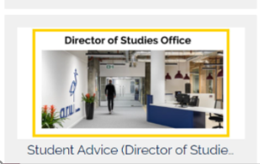
My Modules- Student Advice – Director of Studies Office
Zoom link
How to make a late submission
How to mitigate
How to change course

Slide 39
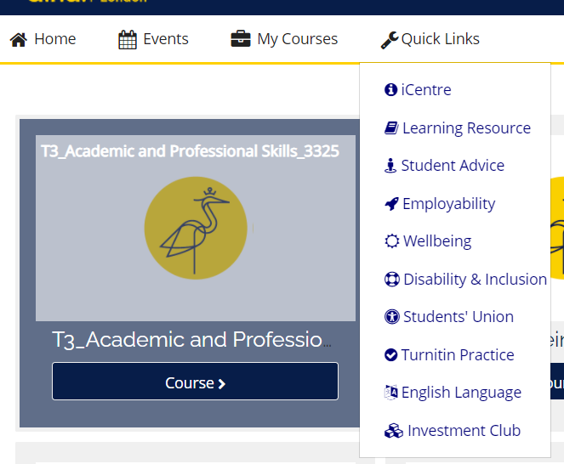
Quick Links You can also use the drop down menu – English Language and the investment club are useful links for now. We will look at Turnitin Practise later in the course .

Slide 40
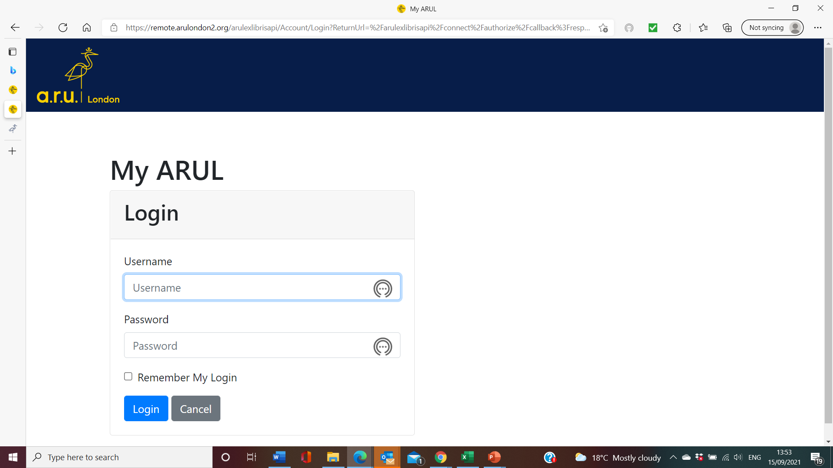
My ARUL – this is the web-based version of the My ARUL App Use your VLE username and password here.

Slide 41

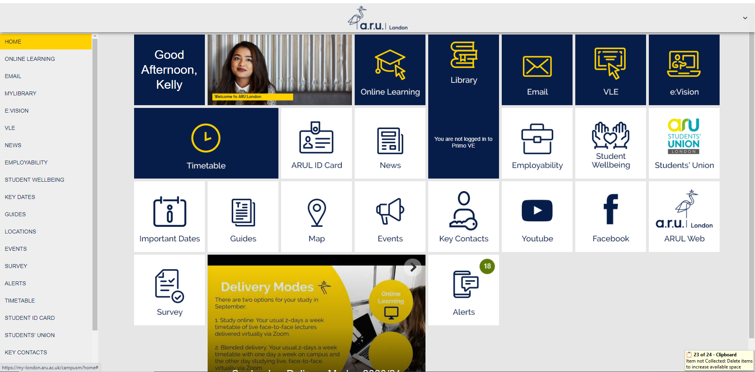
myARUL
Notes:
MY Arul is the desktop version of the app

Slide 42
FAQ - Where to get help – who to ask
Course content - Your lecturer
Attendance recording – attendance@london.aru.ac.uk
Extension/ mitigation – VLE – My Forms- extension form. Mitigation form
Dates – VLE – Academic calendar
Finance (e.g. student loans) – finance@london.aru.ac.uk
Wellbeing – studentwellbeing@london.aru.ac.uk

Slide 43
Homework
Quiz
Watch the class video at the end of the week to review the class content. (You should do this homework every week)
These videos can be found in the Lecture recordings tile at the bottom of the RS1 VLE page (but you already knew that!)
Make sure you can open your textbook. Have your Kortext login details ready.

Slide 44

Q&A

Slide 45
Reference List
Elsworthy, E., 2017. Average British attention span is 14 minutes, research finds. The Independent, 28 December. Available at: Https://www.Independent.Co.Uk/news/uk/home-news/attention-span-average-british-person-tuned-in-concentration-mobile-phone-a8131156.Html
Statista, 2022. Percentage of undergraduate degrees awarded each grade in the UK 2011-2021 [online] Available at https://www.statista.com/statistics/676995/university-degree-awards-uk/#:~:text=In%202018%2C%20approximately%2049%20percent,the%20eleventh%2Dhighest%20in%20Europe [Accessed 22 July 2022].

